Slide 1
Comparisons between 16S and shotgun metagenomics

Slide 2
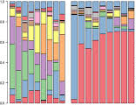

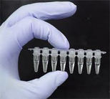
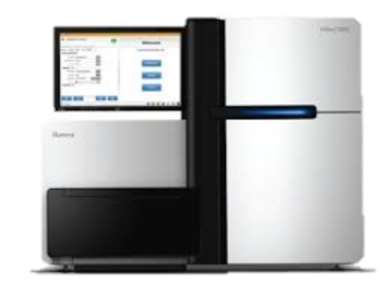
There are differences along this entire workflow except extraction
Extraction
Library Prep
Sequencing
Data Analysis
AGTTCAC
(x 10⁸)

Slide 3
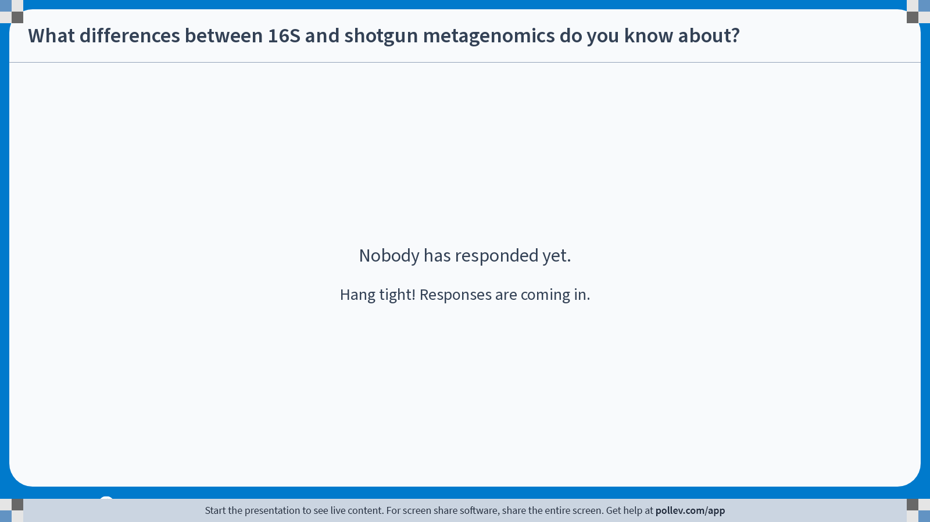
Notes:
Do not modify the notes in this section to avoid tampering with the Poll Everywhere activity. More info at polleverywhere.com/support What differences between 16S and shotgun metagenomics do you know about?
https://www.polleverywhere.com/free_text_polls/G5iVh4dJQYEhrJhjO6yw7

Slide 4
Sample Workflow
All of the differences stem from this key step!!
Extraction
Library Prep
Sequencing
Data Analysis
AGTTCAC
(x 10⁸)

Slide 5
A good overview:
https://blog.microbiomeinsights.com/16s-rrna-sequencing-vs-shotgun-metagenomic-sequencing

